Slide 1
IBC 2018 CHAPTER 6
ORB University
TYPES OF CONSTRUCTION
About this chapter - Chapter 6 establishes five types of construction in which each building must be categorized.

Slide 2
Overview
Per the 2018 IBC Commentary: “Correct classification of a building by its type of construction is essential”
“If a building is placed in a higher incorrect construction classification than necessary, its owner may be penalized by increased construction costs”
“If a building is placed incorrectly into a lower type of construction, it will not be constructed in a manner that takes into account the relative risks associated with its size or function.”

Slide 3
Overview
‘The provisions of this chapter, coupled with Chapters 3 and 5 and Tables 601 and 602, establish the basis for the “equivalent risk theory” on which the entire code is based.’
The IBC wants us to find a balance in efficiency in construction cost with occupant safety.

Slide 4
Overview
- From Archicorner Building Code Videos – AC 004 – Building Types

Slide 5
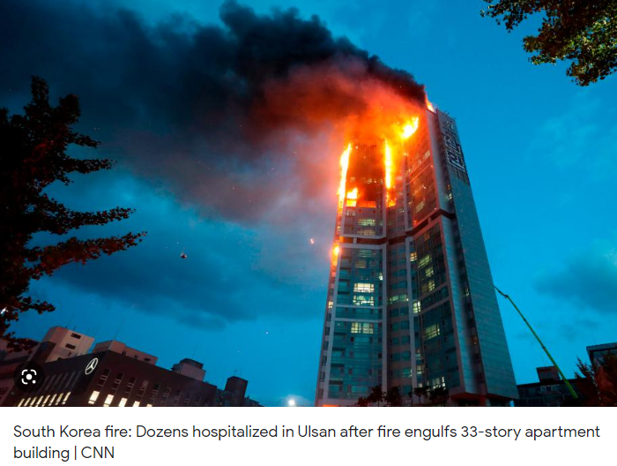
Overview
“The purpose of classifying buildings or structures by their type of construction is to account for the response or participation that a building’s structure will have in a fire condition originating within the building as a result of its occupancy or fuel load.”
-The IBC would rather err on the side of safety
- From the 2018 IBC, Chapter 6 Commentary

Slide 6
Overview
To determine the most optimized Type of Construction to categorize your building in, Chapter 6 questions the materials used and element location:
-Are they combustible or noncombustible?
-What are the building elements proximity to a lot line?
-Tables 601 and 602 will dictate the fire-resistance rating requirements for building elements based on these items

Slide 7
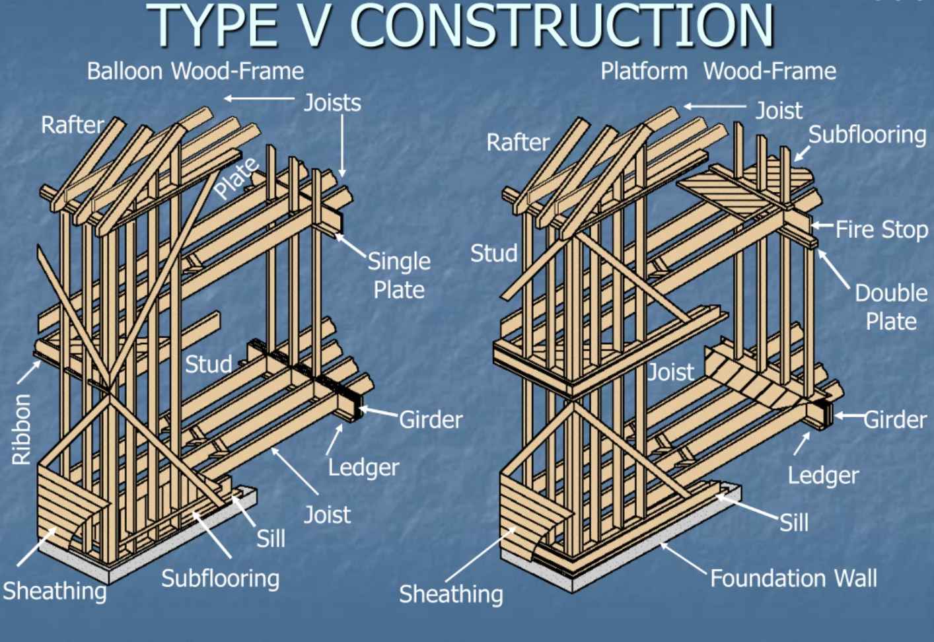
Construction Type Introduction
-The buildings we work on at ORB are Type I, Type III or Type V, or a combination.
-Type V is typically wood-framed construction used commonly in multi-family construction:

Slide 8
Construction Type Introduction
-Type III is “protected combustible” construction used in multi-family to an allowable height dictated by Chapter 5:

Slide 9
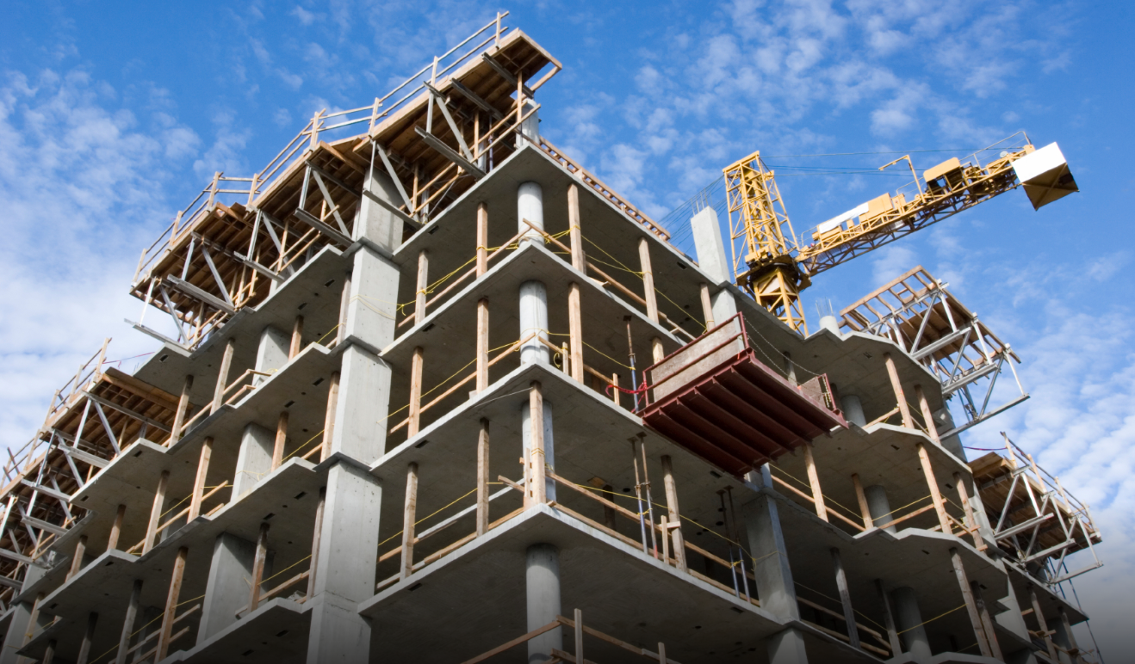
Construction Type Introduction
-Type I is the most stringent fire-resistive category but allows for more freedom in occupancy, area, and height:

Slide 10
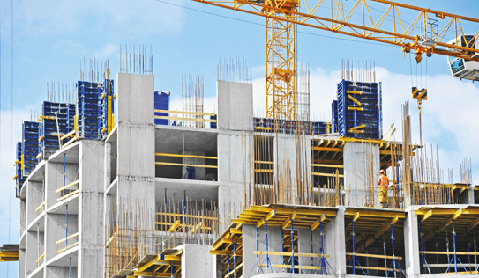
Construction Types – In Detail
Type I: Fire Resistive
-The most stringent fire-resistive standards are applied to high-rise buildings, defined as those over 75 feet tall in the IBC. For these Type IA buildings, all the materials used in construction must be noncombustible (such as concrete or steel) and meet the very highest fire-resistance standards. The structural frame and exterior walls must have fire ratings of at least 3 hours and floors and ceilings of at least 2 hours (Table 601).
-The next half-tier down, Type IB, includes mid-rise office buildings and some residential structures such as apartment buildings and hotels. These have slightly lower fire rating requirements: 2 hours for structural frames and exterior walls, 1 hour for ceilings and floors.

Slide 11
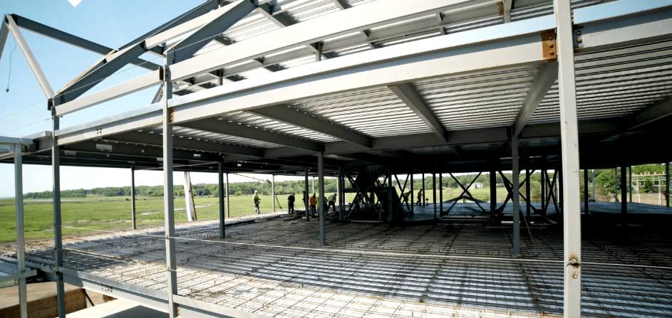
Construction Types
Type II: Non-Combustible
-This tier typically encompasses smaller commercial buildings that do not reach heights of 75 feet or taller. As with Type I buildings, all the structural elements in Type II buildings must be made of non-combustible materials.
-However, it is not necessary to treat them with fire-resistive coatings or otherwise protect them. A steel column or beam may be exposed in a Type II building while it would have to be protected in a Type I structure.

Slide 12
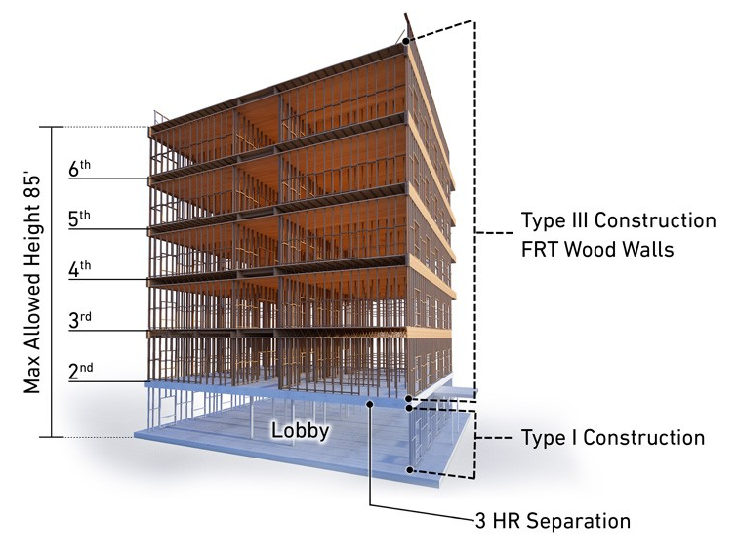
Construction Types
Type III: Ordinary Construction
Type III is divided into two subcategories, A and B. Type IIIA buildings are also called “protected combustible” structures. Their exterior walls are of noncombustible materials, often brick, while internal floors and roofs may be of combustible materials (like wood) that have been rated as fire resistant for up to one hour.
Type IIIB buildings, or “unprotected combustible” buildings have noncombustible exterior walls, while the floors and roofs may be of wood that has not been rated as fire resistant.

Slide 13
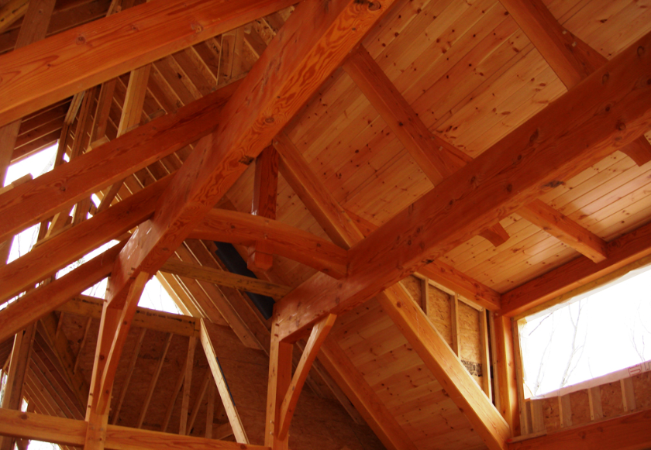
Construction Types
Type IV: Heavy Timber
-Heavy timber buildings have structures built of wood but given the large size of the timbers, they can withstand fires for longer than light wood frame houses. At a minimum the wood columns, beams, and girders of heavy timber structures must be eight inches thick while floor planks must be at least six inches thick. The greater structural mass of these wood elements assures that buildings will remain standing for longer–a fire rating of one hour is required for the structural frame. The exterior walls of Type IV buildings are made of noncombustible materials.

Slide 14
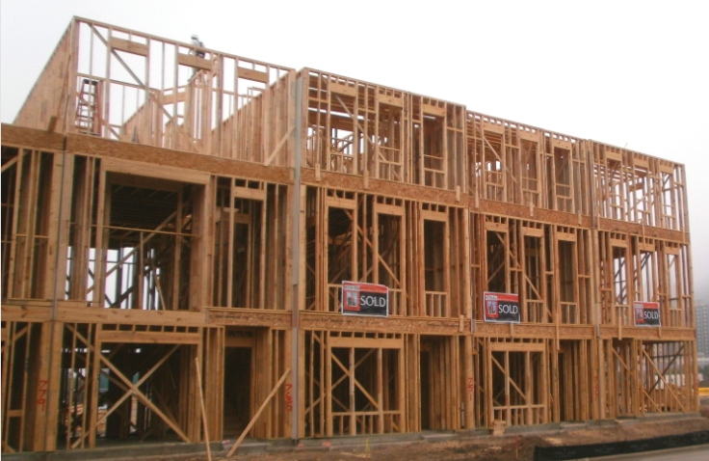
Construction Types
Type V: Wood Frame Construction
-This tier covers buildings that use light wood framing and is also divided into two levels, A and B.
-Type VA buildings are known as “protected frame” constructions and include many newer, small apartment buildings. With these the exterior walls, structural frame, and floors, ceilings, and roofs must be fire-rated for up to one hour.
-Type VB covers most single-family homes and garages and is known as “unprotected frame.” With these structures both the exterior walls and the supports can be made of any materials, including combustible ones, permitted by the IBC.

Slide 15
To Revisit the Purpose of Chapter 6:
Again, we want to determine the most optimized Type of Construction to categorize the building in… so, what should we consider?:
-What does table 601 say about the fire-resistance rating requirements for building elements?
-What does table 602 say about the building elements proximity to a lot line?

Slide 16
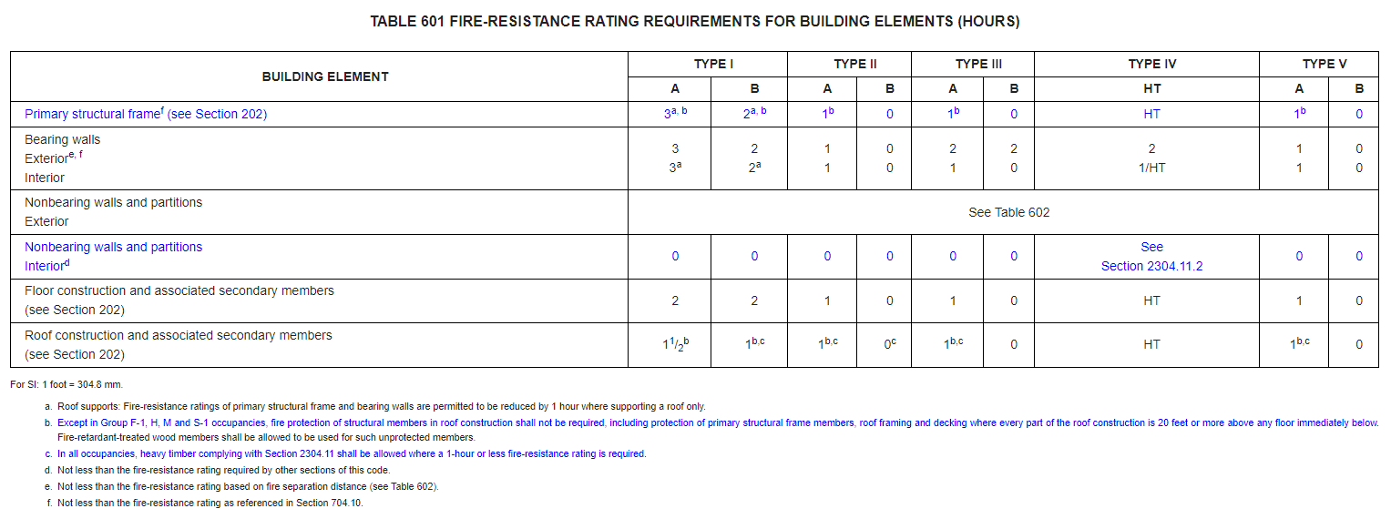
Fire-resistance
Depending on the type of construction you select for the building, fire rating requirements increase or decrease (Table 601):

Slide 17
Remember Cost Efficiency vs. Safety:
- From Archicorner Building Code Videos – AC 004 – Building Types

Slide 18
Fire-Separation Distance
Depending on the proximity of the building to the lot line and the Type of Construction, exterior fire rating requirements increase or decrease (Table 602):

Slide 19
Allowable Area Tieback
Chapter 6 ties back into Chapter 5 where allowable area or desired allowable area is a dictating factor in what Type of Construction to select… See Table 506.2:

Slide 20
Allowable Height Tieback
It also ties back to Chapter 5 where your desired building height and number of stories is a dictating factor in what Type of Construction to select… See Table 504.3:

Slide 21
Allowable Stories Tieback
See Table 504.4 for allowable number of stories:

Slide 22
What did we learn?
Your client wants to save
But the IBC would rather err on the side of safety
You have to find a balance

Slide 23
References
IBC 2018, Chapter 6 and Commentary
-ORB Reference Library, regular version available online:
https://codes.iccsafe.org/content/IBC2018/chapter-6-types-of-construction
Fiebig Architecture Website
https://fiebigarch.com/types-of-construction-in-the-international-building-code/
MT Copeland Website
https://mtcopeland.com/blog/a-guide-to-the-5-types-of-building-construction/
Archicorner Building Code Videos – AC 004 – Building Types
https://www.youtube.com/watch?v=EKRbNlCBLrs
Derek D.

